Slide 1
Structure Query Language (SQL)

Slide 2
Objectives
Example Tables
Introduction
ISO SQL Data Types
Comparison Operators in SQL
Logical Operators in SQL
Arithmetic Operators in SQL
SQL Schema and Catalog
SQL Data Definition Statements (DDL)
SQL Data Manipulation Statements (DML)
Other SQL Operators
Dr. Ejaz Ahmed

Slide 3
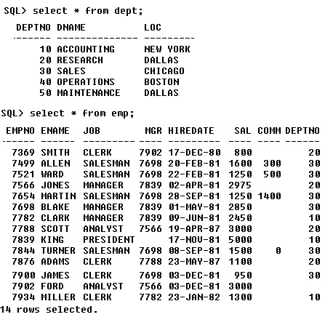
Sample
Tables
Dr. Ejaz Ahmed

Slide 4
Objectives of SQL
Ideally, database language should allow user to:
  create the database and relation structures;
  perform insertion, modification, deletion of data from relations;
  perform simple and complex queries.
Must perform these tasks with minimal user effort and command structure and syntax must be easy to learn.
It must be portable.
SQL does not contain flow control commands. These must be implemented using a programming or job-control language, or interactively by the decisions of the user.
Dr. Ejaz Ahmed
Notes:
September 98
4
Chapter Name

Slide 5
Objectives of SQL …
SQL is relatively easy to learn:
  It is a non-procedural language - you specify what information you require, rather than how to get it.
  It is essentially free-format.
Can be used by a range of users including DBAs, management, application programmers, and other types of end users.
An ISO standard now exists for SQL, making it both the formal and de facto standard language for relational databases.
Dr. Ejaz Ahmed
Notes:
September 98
5
Chapter Name

Slide 6
Objectives of SQL …
Consists of standard English words:
    CREATE TABLE staff(
    sno VARCHAR(5),
      lname VARCHAR(15),
      salary NUMBER(7,2)
      );
    INSERT INTO staff
    VALUES ('SG16', 'Brown', 8300);
    SELECT sno, lname, salary
    FROM staff
    WHERE salary > 10000;
Dr. Ejaz Ahmed
Notes:
September 98
7
Chapter Name

Slide 7
History of SQL …
In 1974, D. Chamberlin (IBM San Jose Laboratory) defined language called 'Structured English Query Language' or SEQUEL.
A revised version SEQUEL/2 was defined in 1976 but name was subsequently changed to SQL for legal reasons.
Still pronounced 'see-quel', though official pronunciation is 's-q-l'.
IBM subsequently produced a prototype DBMS called System R, based on SEQUEL/2.
Roots of SQL, however, are in SQUARE (Specifying Queries as Relational Expressions), which predates System R project.
Dr. Ejaz Ahmed
Notes:
September 98
9
Chapter Name

Slide 8
History of SQL …
In late 70s, ORACLE appeared and was probably first commercial RDBMS based on SQL.
In 1987, ANSI and ISO published an initial standard for SQL.
In 1989, ISO published an addendum that defined an 'Integrity Enhancement Feature'.
In 1992, first major revision to ISO standard occurred, referred to as SQL2 or SQL/92.
Dr. Ejaz Ahmed
Notes:
September 98
11
Chapter Name

Slide 9
Importance of SQL …
SQL has become part of application architectures such as IBM's Systems Application Architecture (SAA).
It is strategic choice of many large and influential organizations (e.g. X/OPEN).
SQL is Federal Information Processing Standard (FIPS) to which conformance is required for all sales of databases to American Government.
Dr. Ejaz Ahmed
Notes:
September 98
12
Chapter Name

Slide 10
Importance of SQL …
SQL Access Group trying to define enhancements that will support interoperability across disparate systems.
SQL is used in other standards and even influences development of other standards as a definitional tool. Examples include:
  ISO's Information Resource Directory System (IRDS) Standard
  Remote Data Access (RDA) Standard.
Dr. Ejaz Ahmed
Notes:
September 98
13
Chapter Name

Slide 11
Components of SQL
A database language must have support for the components listed below. Most implementations of SQL support various components listed below:
  Data Definition Language (DDL)
  Interactive Data Manipulation Language (Interactive DML)
  Embedded Data Manipulation Language (Embedded DML)
  Views
  Integrity and transaction control
  Authorization & Security (DCL)
  Catalog and dictionary facility.
Dr. Ejaz Ahmed

Slide 12
Basic Guidelines for Writing SQL Statements …
SQL statement consists of reserved words and user-defined words.
  Reserved words are a fixed part of SQL and must be split exactly as required and cannot be split across lines.
  User-defined words are made up by user and represent names of various database objects such as relations, columns, views.
Most components of an SQL statement are case insensitive, except for literal character data.
More readable with indentation and lineation:
  Each clause should begin on a new line.
  Start of a clause should line up with start of other clauses.
  If clause has several parts, should each appear on a separate line and be indented under start of clause.
Dr. Ejaz Ahmed
Notes:
September 98
14
Chapter Name

Slide 13
Basic Guidelines for Writing SQL Statements …
Use extended form of BNF notation:
  Upper case letters represent reserved words.
  Lower case letters represent user-defined words.
  | indicates a choice among alternatives.
  Curly braces indicate a required element.
  Square brackets indicate an optional element.
  … indicates optional repetition (0 or more).
  ALL SQL is case less
Dr. Ejaz Ahmed
Notes:
September 98
16
Chapter Name

Slide 14
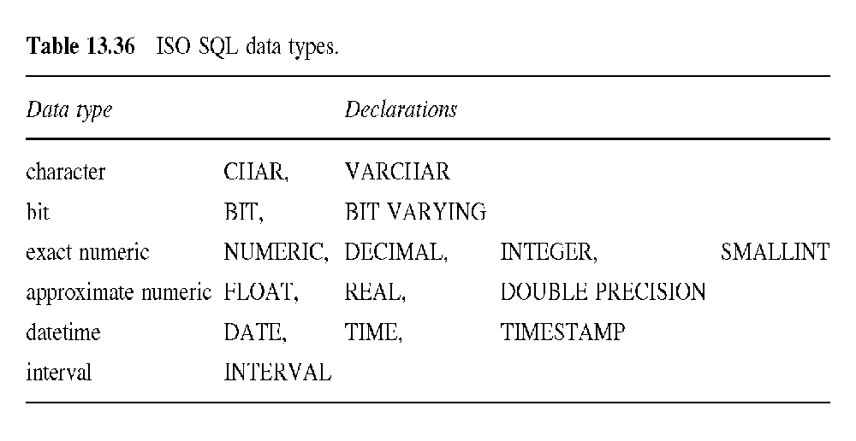
ISO SQL Data Types
Dr. Ejaz Ahmed
Notes:
September 98
145
Chapter Name

Slide 15
Comparison Operators in SQL
There are six comparison operators in SQL. These operators are used to build conditions that are used in the WHERE clause of a DML statement:
Operator
Meaning
=
Equal
<>
Not Equal
<
Less than
>
Greater than
<=
Less than or Eqaul
>=
Greater than or Eqaul
Dr. Ejaz Ahmed

Slide 16
Logical Operators in SQL
There are three logical operators that help us to build compound conditions to be used in the WHERE clause of the SELECT statement.
  The AND operator joins two or more conditions, and display a row only if that row’s data satisfies ALL the specified conditions.
  The OR operator joins two or more conditions, and display a row only if that row’s data satisfies any of the specified conditions.
  The NOT is a unary operator, and is used to negates a condition.
Dr. Ejaz Ahmed

Slide 17
Arithmetic Operators in SQL
Another feature of SQL allows the use of arithmetic in queries.
  The standard arithmetic operators ( +, -, /, *) can be applied to numeric values or attributes with numeric domain.
  The arithmetic operators can be used in expressions in the SELECT and the WHERE clauses to compute numeric values.
  All attributes that can be computed using arithmetic expressions (such as age from birth date, annual salary from monthly salary) must be eliminated as part of a good design practice in databases.
Dr. Ejaz Ahmed

Slide 18
SQL Schema and Catalog
In SQL92, relations and other database objects exist in an environment.
Each environment contains one or more catalogs, and each catalog consists of set of schemas.
Schema is a named collection of related database objects.
Objects in a schema can be tables, views, domains, constraints, translations, and character sets. All have same owner.
Dr. Ejaz Ahmed
Notes:
September 98
146
Chapter Name

Slide 19
SELECT
SELECT Definition
Selecting Columns
Selecting Rows
Sorting
Aggregation
Grouping
Restricting Groups
Aliasing Table Names
Nested Queries
Join
Set Operations
Dr. Ejaz Ahmed

Slide 20
SELECT Definition …
SQL has only one statement for retrieving information from a database called the SELECT statement.
SQL SELECT statement is different from that of Relational Algebra.
An important distinction between SQL and formal relational model is that SQL allows duplicate rows. Hence an SQL table is not a set but a multiset (some times called a bag) of tuples.
Dr. Ejaz Ahmed
Notes:
September 98
17
Chapter Name

Slide 21




Retrieving Information From the Database
John
Smith
Mary
Stiles
Data
DB
Dr. Ejaz Ahmed

Slide 22
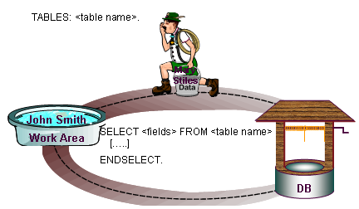
SQL
Dr. Ejaz Ahmed

Slide 23
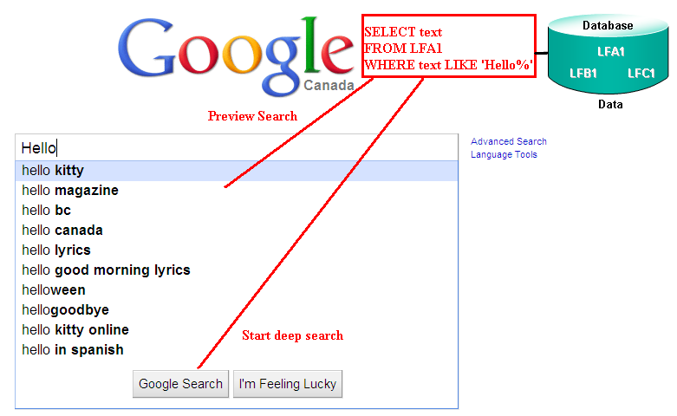
SQL - Usage
Dr. Ejaz Ahmed

Slide 24
SELECT Definition …
A SELECT statement can consist up to six clauses.
  SELECT [DISTINCT | ALL]
  {* | [column_expression [AS new_name]] [,...] }
  FROM table_name [alias] [, ...]
  [WHERE condition]
  [GROUP BY column_list]
  [HAVING condition]
  [ORDER By column_list]
Only SELECT and FROM clauses are mandatory.
Order of the clauses cannot be changed.
Dr. Ejaz Ahmed
Notes:
September 98
17
Chapter Name

Slide 25
SELECT Definition …
FROM Specifies table(s) to be used.
WHERE Filters rows.
GROUP BY Forms groups of rows with same column value.
HAVING Filters groups subject to some condition.
SELECT Specifies which columns are to appear in output.
ORDER BY Specifies the order of the output.
Dr. Ejaz Ahmed
Notes:
September 98
18
Chapter Name

Slide 26
Selecting Columns
Selecting all columns +
Selecting Specific columns +
Selecting Computed columns +
Renaming Columns +
Dr. Ejaz Ahmed

Slide 27
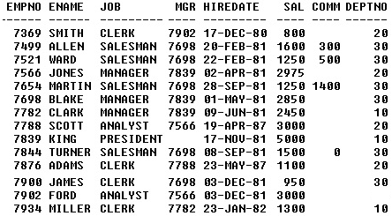
Selecting ALL Columns
SELECT *
FROM emp;
Dr. Ejaz Ahmed

Slide 28
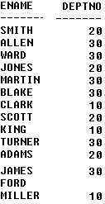
Selecting Specific Columns
SELECT ename, deptno
FROM emp;
Dr. Ejaz Ahmed

Slide 29
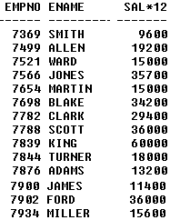
Selecting Computed Columns
SELECT empno, ename, sal*12
FROM emp;
Dr. Ejaz Ahmed

Slide 30
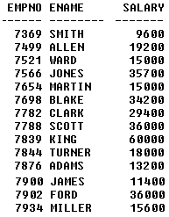
Renaming Columns
SELECT empno, ename, sal*12 salary
FROM emp;
Dr. Ejaz Ahmed

Slide 31
Selecting Rows
Selecting All Rows +
Partial match Search +
Range Search +
Set Membership Search +
Pattern matching Search +
Null Search +
Removing Duplicate Rows +
Dr. Ejaz Ahmed

Slide 32
Selecting ALL Rows
SELECT *
FROM emp;
Dr. Ejaz Ahmed

Slide 33
Selecting Rows
To Select certain rows of a table you need to use the WHERE clause of the SELECT statement.
The WHERE clause has a condition which is a logical expression.
The Where condition consists of:
  Comparison Operators
  Logical Operators
  Arithmetic Operators
  Other SQL constructs which will be discussed later.
A record to be selected it must make the WHERE logical expression true. In other words it must satisfy the where condition.
Dr. Ejaz Ahmed

Slide 34

Partial Match Columns
SELECT *
FROM emp
WHERE deptno=20;
Dr. Ejaz Ahmed

Slide 35

Partial Match Columns …
SELECT *
FROM emp
WHERE deptno=20
AND job = 'CLERK';
Dr. Ejaz Ahmed

Slide 36
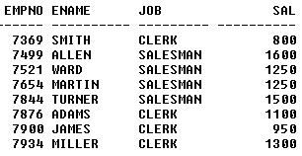
Range Search …
Selecting all the records whose column values is between the values specified in the WHERE clause.
SELECT empno, ename, job, sal
FROM emp
WHERE sal >=800 AND sal <= 2000;
SELECT empno, ename, job, sal
FROM emp
WHERE sal BETWEEN 800 and 2000;
Dr. Ejaz Ahmed

Slide 37
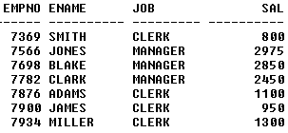
Set Membership Search …
Selecting all the records whose column value is a member of the set specified in the WHERE clause.
SELECT empno, ename, job, sal
FROM emp
WHERE job IN ('CLERK', 'MANAGER');
Dr. Ejaz Ahmed

Slide 38
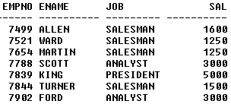
Set Membership Search …
Selecting all the records whose column value is a member of the set specified in the WHERE clause.
SELECT empno, ename, job, sal
FROM emp
WHERE job NOT IN ('CLERK', 'MANAGER');
Dr. Ejaz Ahmed

Slide 39
Pattern Matching Search …
SQL has two special pattern matching symbols:
  %: sequence of zero or more characters;
  _ (underscore): any single character.
LIKE '%dd%' means a sequence of characters of any length containing ‘dd'.
Dr. Ejaz Ahmed
Notes:
September 98
40
Chapter Name

Slide 40

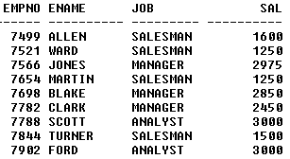
Pattern Matching Search …
Selecting all the records whose column value is a member of the set specified in the WHERE clause.
SELECT empno, ename, job, sal
FROM emp
WHERE job LIKE 'A%';
SELECT empno, ename, job, sal
FROM emp
WHERE job LIKE '%AN%';
Dr. Ejaz Ahmed
Notes:
%A or _A

Slide 41

NULL SEARCH
Selecting all employees with Commission and without Commission. Means Commission is available or not available
SELECT empno, ename, sal, comm
FROM emp
WHERE comm is NOT NULL;
SELECT empno, ename, sal, comm
FROM emp
WHERE comm is NULL;
Dr. Ejaz Ahmed

Slide 42


REMOVING DUPLICATE ROWS
Selecting all employees with Commission and without Commission. Means Commission is available or not available
SELECT job
FROM emp;
SELECT DISTINCT job
FROM emp;
Dr. Ejaz Ahmed

Slide 43
Sorting
The ORDER BY clause specifies an order for displaying the result of a query.
  SQL allows the user to order the tuples in the result of a query by the values of one or more attributes; the default order is ascending or increasing.
  The keyword DESC is specified to sort in a descending order of values while the keyword ASC can be used to specify ascending order explicitly.
  The sorting will be applied alphabetically or numerically depending on the type of the column attribute.
Dr. Ejaz Ahmed

Slide 44
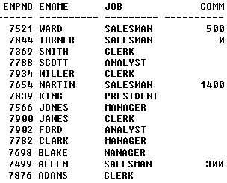
SORTING
Sorting records in Ascending, Descending orders
SELECT empno, ename, job, comm
FROM emp
ORDER BY ename DESC, comm ASC;
SELECT empno, ename, sal, comm
FROM emp
ORDER BY job, sal DESC;
Dr. Ejaz Ahmed

Slide 45
Aggregation …
ISO standard defines five aggregate functions:
  COUNT returns number of values in a specified column.
  SUM returns sum of values in a specified column.
  AVG returns average of values in a specified column.
  MIN returns smallest value in a specified column.
  MAX returns largest value in a specified column.
Applied on numeric and text columns both
Dr. Ejaz Ahmed
Notes:
September 98
49
Chapter Name

Slide 46
Aggregation …
Each operates on a single column of a table and return single value.
COUNT, MIN, and MAX apply to numeric and non-numeric fields, but SUM and AVG may be used on numeric fields only.
Apart from COUNT(*), each function eliminates nulls first and operates only on remaining non-null values.
COUNT(*) counts all rows of a table, regardless of whether nulls or duplicate values occur.
Can use DISTINCT before column name to eliminate duplicates.
Dr. Ejaz Ahmed
Notes:
September 98
50
Chapter Name

Slide 47
Aggregation …
DISTINCT has no effect with MIN/MAX, but may have with SUM/AVG.
Aggregate functions can be used only in SELECT list and in HAVING clause.
If SELECT list includes an aggregate function and there is no GROUP BY clause, then SELECT list cannot reference a column with an aggregate function. For example, following is illegal:
SELECT job, COUNT(*)
  FROM emp;
Dr. Ejaz Ahmed
Notes:
September 98
51
Chapter Name

Slide 48


Example: COUNT
How many rows in table EMP?
How many job titles in EMP?
SELECT COUNT(*)
FROM emp;
SELECT COUNT(DISTINCT job)
FROM emp;
Dr. Ejaz Ahmed

Slide 49


Example: SUM
Find the total of all salaries in EMP?
Find the total of salaries of employees of dept 10?
SELECT SUM(sal)
FROM emp;
SELECT SUM(sal) TotSalary
FROM emp
WHERE deptno=10;
Dr. Ejaz Ahmed

Slide 50

Example: MIN, MAX, AVG
Find the minimum, maximum, and average salary of all employees
SELECT MIN(sal) Min_sal,
MAX(sal) Max_sal,
AVG(sal) Average_sal
FROM emp;
Dr. Ejaz Ahmed

Slide 51

Grouping
Use GROUP BY clause to get sub-totals.
SELECT and GROUP BY closely integrated: each item in SELECT list must be single-valued per group, and SELECT clause may only contain:
  Column names.
  Aggregate functions.
  Constants.
  An expression involving combinations of the above.
All column names in SELECT list must appear in GROUP BY clause unless name is used only in an aggregate function.
If WHERE is used with GROUP BY, WHERE is applied first, then groups are formed from remaining rows satisfying predicate.
ISO considers two nulls to be equal for purposes of GROUP BY.
Dr. Ejaz Ahmed
Notes:
September 98
57
Chapter Name
Group by is managed with Aggregate Function and a column (on which grouping is applied)

Slide 52
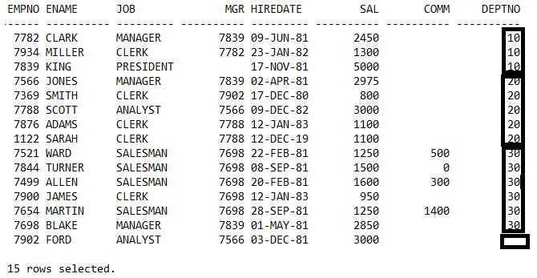
Example: GROUPING
Which columns can be grouped?
Grouping
*
3
5
6
1
Let’s build group-by SQL.
Dr. Ejaz Ahmed
Notes:
Which columns can be grouped?
Job, mgr, deptno
List the number of employees on each department?
Select deptno, count(*)
From emp
Group by deptno;
Select deptno, sum(sal)
From emp
Group by deptno;
Can be further extended to:
List the number of employees and their total salary in each department?

Slide 53

GROUPING
Find the number of employees in each department.
You may think to write 3 queries for each department
SELECT COUNT(*) FROM emp
WHERE deptno = 10;
SELECT COUNT(*) FROM emp
WHERE deptno = 20;
SELECT COUNT(*) FROM emp
WHERE deptno = 30;
But we want like this
Dr. Ejaz Ahmed
Notes:
Hardcoded queries, any issue with these queries?

Slide 54


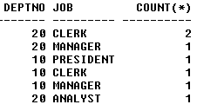
Example: GROUPING (Rolling up)
Find the number of employees in each department (or Roll up by department).
Find the number of employees in each department & with job title.
SELECT deptno, job, COUNT(*)
FROM emp
WHERE deptno IN (10,20)
GROUP BY deptno, job;
Dr. Ejaz Ahmed

Slide 55
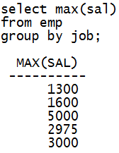
Example: GROUPING
Executable SQL with Group by but meaningless output.
Dr. Ejaz Ahmed

Slide 56
Restricting Groups
HAVING clause is designed for use with GROUP BY clause to restrict groups that appear in final result table.
Similar to WHERE, but WHERE filters individual rows whereas HAVING filters groups.
Column names in HAVING clause must also appear in the GROUP BY list or be contained within an aggregate function.
Dr. Ejaz Ahmed
Notes:
September 98
61
Chapter Name

Slide 57
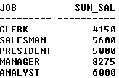

Example: Restricting Groups
Group By with conditions
You can use WHERE before Group By
SELECT job, SUM(sal) SUM_SAL
FROM emp
GROUP BY job;
SELECT job, SUM(sal) SUM_SAL
FROM emp
GROUP BY job
HAVING SUM(sal)>5000;
Dr. Ejaz Ahmed
Notes:
SQL> select deptno, avg(sal), min(sal)
2 from emp
3 group by deptno
4 having avg(sal)>min(sal);
DEPTNO AVG(SAL) MIN(SAL)
---------- ---------- ----------
30 1566.66667 950
20 1795 800
10 2916.66667 1300
SQL> select deptno, avg(sal), min(sal)
2 from emp
3 group by deptno
4 having avg(sal)> (select min(sal)
5 from emp);
DEPTNO AVG(SAL) MIN(SAL)
---------- ---------- ----------
30 1566.66667 950
3000 3000
20 1795 800
10 2916.66667 1300

Slide 58
Aliasing Table Names
A table alias is created by directly placing an alias after the table name in the FROM clause.
The advantage of using a table alias when performing JOIN is readily apparent when we discuss JOIN later.
For example in the following example we will refer to departments table as d and employee table as e.
SELECT d.dname
FROM dept d
WHERE d.deptno = 10;
SELECT e.ename, e.sal
FROM emp e
WHERE e.deptno = 10;
Dr. Ejaz Ahmed

Slide 59
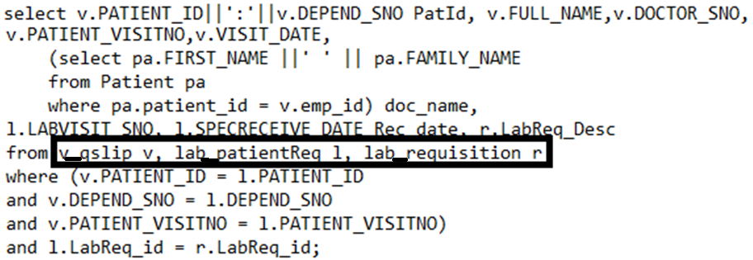
Sample Query with Aliasing Table Names
Dr. Ejaz Ahmed

Slide 60
Nested or Sub Queries
Some SQL statements can have a SELECT embedded within them.
A subselect can be used in WHERE and HAVING clauses of an outer SELECT, where it is called a nested query or a subquery.
Subselects may also appear in INSERT, UPDATE, and DELETEs.
Dr. Ejaz Ahmed
Notes:
September 98
64
Chapter Name
SQL> select deptno, avg(sal), min(sal)
2 from emp
3 group by deptno
4 having avg(sal)>min(sal);
DEPTNO AVG(SAL) MIN(SAL)
---------- ---------- ----------
30 1566.66667 950
20 1795 800
10 2916.66667 1300
SQL> select deptno, avg(sal), min(sal)
2 from emp
3 group by deptno
4 having avg(sal)> (select min(sal)
5 from emp);
DEPTNO AVG(SAL) MIN(SAL)
---------- ---------- ----------
30 1566.66667 950
3000 3000
20 1795 800
10 2916.66667 1300

Slide 61
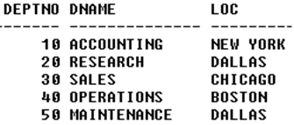
Nested or Sub Queries
List of employees who are belong to department name Research
SELECT *
FROM emp
WHERE deptno IN (
SELECT deptno
FROM dept
WHERE dname = 'RESEARCH');
Inner select
Executed First
Outer select
Dr. Ejaz Ahmed

Slide 62
Nested or Sub Queries
List of employees whose salary is more than the average salary of department 30
SELECT *
FROM emp
WHERE sal > (
SELECT AVG(sal)
FROM emp
WHERE deptno=30
);
Single Record
Executed First
Dr. Ejaz Ahmed

Slide 63
Nested Query Rules
ORDER BY clause may not be used in a subquery (although it may be used in outermost SELECT).
Subquery SELECT list must consist of a single column name or expression, except for subqueries that use EXISTS.
By default, column names refer to table name in FROM clause of subquery. Can refer to a table in FROM using an alias.
When subquery is an operand in a comparison, subquery must appear on right-hand side.
A subquery may not be used as an operand in an expression.
Dr. Ejaz Ahmed
Notes:
September 98
71
Chapter Name

Slide 64
Example: Nested or Sub Queries
List of employees whose salaries is higher than the salary of at least one employee from department Research
SELECT *
FROM emp
WHERE sal > ( SELECT MIN(sal)
FROM emp
WHERE deptno = ( SELECT deptno
FROM dept
WHERE dname = 'RESEARCH‘));
Dr. Ejaz Ahmed

Slide 65
Example: Nested or Sub Queries
List of employees whose salaries is higher than the salary of every employee from department Research
SELECT *
FROM emp
WHERE sal > ( SELECT MAX(sal)
FROM emp
WHERE deptno = ( SELECT deptno
FROM dept
WHERE dname = 'RESEARCH‘));
Dr. Ejaz Ahmed

Slide 66
Join
Can use subqueries provided result columns come from same table.
If result columns come from more than one table must use a join.
To perform join, include more than one table in FROM clause.
Use comma as separator and typically include WHERE clause to specify join column(s).
Also possible to use an alias for a table named in FROM clause.
Alias is separated from table name with a space.
Alias can be used to qualify column names when there is ambiguity.
Dr. Ejaz Ahmed
Notes:
September 98
81
Chapter Name

Slide 67
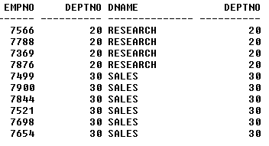
Example: Join (Inner Join)
The default type of join is inner join, where arrow is included in the result only if matching row exists in the other relation.
SELECT e.empno, e.deptno, d.dname, d.deptno
FROM dept d, emp e
WHERE d.deptno=e.deptno
AND d.dname IN ('SALES','RESEARCH');
PK-FK never makes default join, must specify Join in SQL
Dr. Ejaz Ahmed

Slide 68
Example: Join (Inner Join) …
To obtain correct rows, include only those rows from both tables that have identical values in the dno columns: a.dno = b.dno.
These two columns are the matching columns for two tables.
This type of join is also called inner join and they equivalent to equi-join in relational algebra.
Dr. Ejaz Ahmed
Notes:
September 98
84
Chapter Name

Slide 69
Computing a Join
Procedure for generating results of a SELECT with a join are:
  Form Cartesian product of the tables named in FROM clause.
  If there is a WHERE clause, apply the search condition to each row of the product table, retaining those rows that satisfy the condition.
  For each remaining row, determine the value of each item in the SELECT list to produce a single row in the result table.
  If SELECT DISTINCT has been specified, eliminate any duplicate rows from the result table.
  If there is an ORDER BY clause, sort the result table as required.
Dr. Ejaz Ahmed
Notes:
September 98
94
Chapter Name

Slide 70
Outer Joins
With an inner join, if one row of a table is unmatched, row is omitted from result table.
The outer join operations retain rows that do not satisfy the join condition.
There are three types of OUTER JOIN
  Left Outer Join
  Right Outer Join
  Full Outer Join
Lets discuss inner join then we will come back to outer join.
Query execution (very high Performance) is much better than other joins
Dr. Ejaz Ahmed
Notes:
September 98
97
Chapter Name

Slide 71
Performance using outer join
SQL> select count(*)
2 from patient p, patient_visit v
3 where p.patient_id=v.patient_id;
COUNT(*)
----------
37289
Elapsed: 00:00:01.43
SQL> select count(*)
2 from patient p, patient_visit v
3 where p.patient_id(+)=v.patient_id
4 and first_name is not null;
COUNT(*)
----------
37289
Elapsed: 00:00:00.13
Dr. Ejaz Ahmed

Slide 72
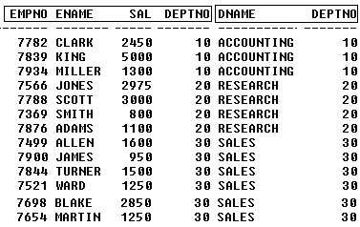
For understanding of an Outer Join
Inner join of departments and lecturers tables will result in the following output.
SELECT e.empno, e.ename, e.sal,
e.deptno, d.dname, d.deptno
FROM emp e, dept d
WHERE e.deptno=d.deptno;
It is an equijoin, not outer joing
Dr. Ejaz Ahmed

Slide 73
Outer Join …
Result table has two rows where the deptno are the same.
There are no rows corresponding to Maintenance or Ford.
To include unmatched rows in result table, use an outer joins.
Benefit: Fastest execution of query
Dr. Ejaz Ahmed
Notes:
September 98
99
Chapter Name

Slide 74
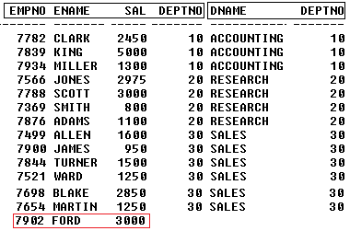
Example: Left Outer Join
List of employees who are belong to departments and who are not belong to any department
SELECT e.empno, e.ename, e.sal,
e.deptno, d.dname, d.deptno
FROM emp e, dept d
WHERE e.deptno=d.deptno (+);
Dr. Ejaz Ahmed

Slide 75
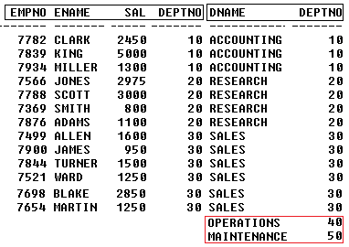
Example: Right Outer Join
List of departments which are departments of employees and which are not.
SELECT e.empno, e.ename, e.sal,
e.deptno, d.dname, d.deptno
FROM emp e, dept d
WHERE e.deptno (+)=d.deptno;
Dr. Ejaz Ahmed

Slide 76
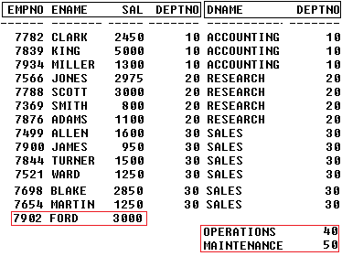
Example: Full Outer Join
List of employees and department which are matched or unmatched from both tables
(SELECT e.empno, e.ename, e.sal,
e.deptno, d.dname, d.deptno
FROM emp e, dept d
WHERE e.deptno=d.deptno (+) )
UNION
(SELECT e.empno, e.ename, e.sal,
e.deptno, d.dname, d.deptno
FROM emp e, dept d
WHERE e.deptno (+) =d.deptno);

Slide 77
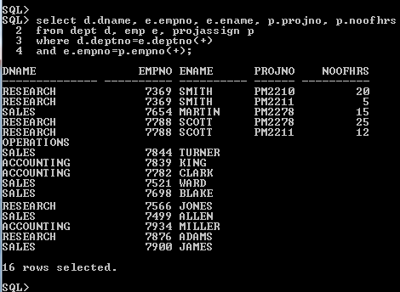
Example: Left Outer Join (3-Tables)…
Dr. Ejaz Ahmed
Notes:
Query displays same person works different projects. Many employees work in same project. Department does not have any employee nor associated with any project

Slide 78
Characteristic of Outer Join
Left Outer Join:
  Includes those rows of first (left) table unmatched with rows from second (right) table.
  Columns from second table are filled with NULLs.
Right outer Join :
  includes those rows of second (right) table that are unmatched with rows from first (left) table.
  Columns from first table are filled with NULLs.
Full Outer Join:
  Is the UNION of both left and right outer joins.
Dr. Ejaz Ahmed
Notes:
September 98
101
Chapter Name

Slide 79
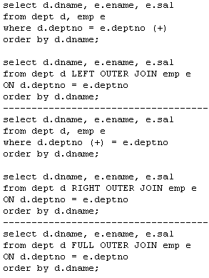
Examples: Left, Right and Full Outer Joins
Dr. Ejaz Ahmed

Slide 80
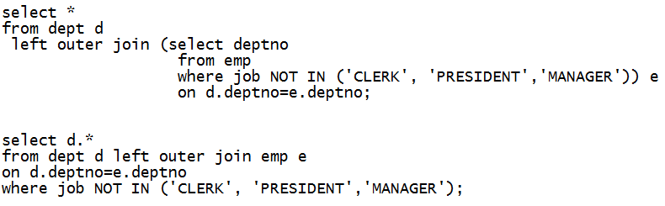
Exercise – Outer Join
Dr. Ejaz Ahmed

Slide 81
Union, Intersect, and Difference
Can use normal set operations of union, intersection, and difference to combine results of two or more queries into a single result table.
Union of two tables, A and B, is table containing all rows in either A or B or both.
Intersection is table containing all rows common to both A and B.
Difference is table containing all rows in A but not in B.
Two tables must be union compatible.
If ALL specified, result can include duplicate rows
Dr. Ejaz Ahmed
Notes:
September 98
112
Chapter Name

Slide 82
Example: Use of UNION
Input Tables
List all the department nos 10, 20 salaries. Remove duplicates
List all the department nos 10, 20 salaries. Including duplicates
SELECT sal, dno
FROM emp
WHERE deptno = 10
UNION
SELECT sal, dno
FROM emp
WHERE deptno = 20;
SELECT sal, dno
FROM emp
WHERE deptno = 10
UNION ALL
SELECT sal, dno
FROM emp
WHERE deptno = 20;
Dr. Ejaz Ahmed
Notes:
September 98
115
Chapter Name

Slide 83
Example: Use of UNION …
Input Tables
List all the ICS and COE faculty salaries. Remove duplicates
List all the ICS and COE faculty salaries. Include duplicates
SELECT salary
FROM lecturers
WHERE dno =
( SELECT dno
FROM departments
WHERE dname= ‘ICS’
)
UNION
SELECT salary
FROM lecturers
WHERE dno =
( SELECT dno
FROM departments
WHERE dname= ‘COE’
);
SELECT salary
FROM lecturers
WHERE dno =
( SELECT dno
FROM departments
WHERE dname= ‘ICS’
)
UNION ALL
SELECT salary
FROM lecturers
WHERE dno =
( SELECT dno
FROM departments
WHERE dname= ‘COE’
);
Dr. Ejaz Ahmed
Notes:
September 98
115
Chapter Name

Slide 84
Example: Use of DIFFERENCE
Input Tables
List salaries that are taken by ICS and not COE lecturers.
SELECT salary
FROM lecturers
WHERE dno = (
SELECT dno
FROM departments
where dname= ‘ICS’
)
MINUS
SELECT salary
FROM lecturers
WHERE dno = (
SELECT dno
FROM departments
WHERE dname= ‘COE’
);
Dr. Ejaz Ahmed
Notes:
September 98
115
Chapter Name

Slide 85
Example: Use of INTESECTION
Input Tables
List salaries that are taken by both COE and ICS lecturers.
SELECT salary
FROM lecturers
WHERE dno = (
SELECT dno
FROM departments
where dname= ‘ICS’
)
INTERSECTION
SELECT salary
FROM lecturers
WHERE dno = (
SELECT dno
FROM departments
WHERE dname= ‘COE’
);
Produces result tables from both queries and creates single result table consisting of those rows that are common to both result tables.
Dr. Ejaz Ahmed
Notes:
September 98
115
Chapter Name

Slide 86
Other SQL Operators
IN (covered)
BETWEEN (covered)
LIKE (covered)
ANY (SOME)
ALL
EXISTS
NOT EXISTS
Dr. Ejaz Ahmed

Slide 87
ANY (SOME) and ALL
ANY and ALL may be used with subqueries that produce a single column of numbers.
If subquery preceded by ALL, condition will only be true if it is satisfied by all values produced by subquery.
If subquery preceded by ANY, condition will be true if it is satisfied by any values produced by subquery.
If subquery is empty, ALL returns true, ANY returns false.
ISO standard allows SOME to be used in place of ANY.
Dr. Ejaz Ahmed
Notes:
September 98
75
Chapter Name

Slide 88
Example using the SOME Operator
Input Tables
Find lecturers whose salary higher than the salary of at least 1 COE lecturer.
SELECT *
FROM Lecturers
WHERE salary > SOME (
  );
  SELECT salary
  FROM lecturers
  WHERE dno = (
  )
SELECT DNO
FROM department
WHERE dname = ‘COE’
Convert previous nested queries by using SOME, ALL
Dr. Ejaz Ahmed
Notes:
September 98
77
Chapter Name

Slide 89
Example Using the ALL Operator
Find lecturers whose salary higher than the salary of every COE lecturer.
SELECT *
FROM Lecturers
WHERE salary > ALL (
  );
  SELECT salary
  FROM lecturers
  WHERE dno = (
  )
SELECT DNO
FROM department
WHERE dname = ‘COE’
Dr. Ejaz Ahmed
Notes:
September 98
77
Chapter Name

Slide 90
EXISTS and NOT EXISTS
EXISTS and NOT EXISTS are for use only with subqueries specially with correlated subqueries. A correlated subquery is a subquery where some attributes of the outer select are used in the inner select.
They produce a simple true/false result.
EXISTS is true if and only if there exists at least one row in result table returned by subquery.
It is false if subquery returns an empty result table.
NOT EXISTS is the opposite of EXISTS.
Since EXISTS and NOT EXISTS check only for existence or non-existence of rows in subquery result table, subquery can contain any number of columns.
Dr. Ejaz Ahmed
Notes:
September 98
106
Chapter Name

Slide 91
--- Example using the EXISTS Operator
Input Tables
Find all ICS lecturers.
SELECT *
FROM lecturers a
WHERE EXISTS
  (
  SELECT 1
  FROM department b
  WHERE a.dno = b.dno
  AND b.dname = ‘ICS‘
  );
Convert previous nested queries by using SOME, ALL
Dr. Ejaz Ahmed
Notes:
September 98
108
Chapter Name

Slide 92
Example using the NOT EXISTS Operator
Find all non ICS lecturers.
SELECT *
FROM lecturers a
WHERE NOT EXISTS
  (
  SELECT 1
  FROM department b
  WHERE a.dno = b.dno
  AND b.dname = ‘ICS‘
  );
Convert previous nested queries by using EXISTS and NO EXISTS
Dr. Ejaz Ahmed
Notes:
September 98
108
Chapter Name

Slide 93
More SQL Functions
SUBSTR
INSTR
LENGTH
LEFT, RIGHT
LPAD, RPAD
TRIM
DECODE
CEIL
ROWNUM
TO_CHAR
TO_DATE
TO_NUMBER
ADD_MONTHS
FLOOR
SYSDATE
NVL
TRANSLATE
Dr. Ejaz Ahmed

Slide 94
SQL Data Definition Statements (DDL)
CREATE SCHEMA and DROP SCEHMA +
CREATE TABLE +
ALTER TABLE +
DROP TABLE +
Dr. Ejaz Ahmed

Slide 95
CREATE SCHEMA and DROP SCHEMA
  CREATE SCHEMA [name| AUTHORIZATION creator_id ];
  Example: CREATE USER COMPANY IDENTIFIED BY password;
  DROP SCHEMA name [RESTRICT | CASCADE ];
  Example: DROP USER COMPANY CASCADE;
With RESTRICT (default), schema must be empty or operation fails.
With CASCADE, operation cascades to drop all objects associated with schema in the order defined above. If any of these operations fail, DROP SCHEMA fails.
Dr. Ejaz Ahmed
Notes:
September 98
147
Chapter Name
In oracle, create user command will create schema with size or quota of total size of data file.

Slide 96
CREATE TABLE
  CREATE TABLE table_name
  (col_name data_type [NULL | NOT NULL] [,...]);
Creates a table with one or more columns of the specified data_type.
NULL (default) indicates whether column can contain nulls.
With NOT NULL, system rejects any attempt to insert a null in the column.
Primary keys should always be specified as NOT NULL.
Foreign keys are often (but not always) candidates for NOT NULL.
Dr. Ejaz Ahmed
Notes:
September 98
148
Chapter Name

Slide 97
CREATE TABLE – Example 1
CREATE TABLE Employee
(
fname VARCHAR2(15) NOT NULL,
minit CHAR,
lname VARCHAR2(15) NOT NULL,
ssn CHAR(9),
bdate DATE,
address VARCHAR2(50),
sex CHAR,
salary NUMBER(10,2) NOT NULL,
Superssn CHAR(9),
dno NUMBER(3) NOT NULL,
CONSTRAINT employee_ssn_pk PRIMARY KEY(ssn),
CONSTRAINT employee_superssn_fk
FOREIGN KEY(Superssn) REFERENCES employee(ssn),
CONSTRAINT employee_dno_fk
FOREIGN KEY(dno) REFERENCES department(dnumber),
);
Dr. Ejaz Ahmed
Notes:
September 98
150
Chapter Name

Slide 98
CREATE TABLE – Example 2
CREATE TABLE department
(
dname VARCHAR2(15) NOT NULL,
dnumber NUMBER(3) NOT NULL,
mgrssn CHAR(9),
mgrStartDate DATE,
CONSTRAINT department_dnumber_pk
PRIMARY KEY(dnumber),
CONSTRAINT department_mgrssn_fk
FOREIGN KEY(mgrssn) REFERENCES employee(ssn)
);
Dr. Ejaz Ahmed
Notes:
September 98
151
Chapter Name

Slide 99
DROP TABLE
DROP TABLE tbl_name [RESTRICT | CASCADE]
  e.g. DROP TABLE employee;
Removes named table and all rows within it.
With RESTRICT, if any other objects depend for their existence on continued existence of this table, SQL does not allow request.
With CASCADE, SQL drops all dependent objects (and objects dependent on these objects).
Dr. Ejaz Ahmed
Notes:
September 98
152
Chapter Name

Slide 100
ALTER TABLE
The ALTER command is a schema modification command.
It is used to add or drop a column, change a column definition, add or drop table constraints.
Examples:
  ALTER TABLE COMPANY.EMPLOYEE
  MODIFY(Lname VARCHAR2(30));
  ALTER TABLE EMP
  ADD Constraints pk_emp primary key (EMPNO);
  ALTER TABLE EMP
  ADD CONSTRAINTS FK_DEPTNO FOREIGN KEY (DEPTNO)
  REFERENCES DEPT(DEPTNO);
Dr. Ejaz Ahmed
Notes:
How to drop or disable/enable constraints on table, how to add and drop columns on table. How to put unique constraint on table
How to reduce size of existing column of a table.

Slide 101
SQL Data Manipulation Statements (DML)
INSERT Statement +
UPDATE Statement +
DELETE Statement +
Note: Use following control commands for above SQL
Commit for DO or confirm
Rollback for UNDO
Dr. Ejaz Ahmed

Slide 102
INSERT Statement
Definition of INSERT Statement +
Types of INSERT Statement +
INSERT and Integrity Constraints +
Dr. Ejaz Ahmed

Slide 103
Definition of INSERT Statement
INSERT is used to add a single row to a table where we specify the relation name and a list of values for the row.
There are three types of INSERT Statement:
  INSERT With Column list +
  INSERT Without Column list +
  INSERT with SELECT Statement +
Dr. Ejaz Ahmed
Notes:
September 98
128
Chapter Name

Slide 104
INSERT with Column list
INSERT INTO table_name (column_list) VALUES (data_value_list);
Example: INSERT INTO employee(fname, lname, ssn, salary, dno)
  VALUES (‘Majid', ‘Al-Ghamdi', ‘1111111', 4000, 123);
data_value_list must match column_list as follows:
  Number of items in each list must be the same.
  Must be direct correspondence in position of items in two lists.
  Data type of each item in data_value_list must be compatible with data type of corresponding column.
  If one of the table columns is omitted from the column_list It must also be omitted from the data_value_list and make sure it is nullable.
Dr. Ejaz Ahmed
Notes:
September 98
128
Chapter Name

Slide 105
INSERT without Column List
INSERT INTO table_name VALUES (data_value_list);
Example: INSERT INTO employee
  VALUES (‘Adel', NULL, ‘Al-Eid', ‘222222’,
  NULL, NULL, NULL, NULL, NULL, 1);
data_value_list must match the columns of the table as follows:
  Number of items in the list must be equal to the number of columns of the table.
  Data type of corresponding items must be compatible.
Dr. Ejaz Ahmed
Notes:
September 98
131
Chapter Name

Slide 106
INSERT … SELECT
Second form of INSERT allows multiple rows to be copied from one or more tables to another:
INSERT INTO table_name [ (column_list) ] SELECT ...
Example:
INSERT INTO Table1 (A1, A2, A3)
SELECT B1, B2, B3 FROM Table2;
Dr. Ejaz Ahmed
Notes:
September 98
133
Chapter Name

Slide 107
INSERT and Integrity Constraints
A DBMS that fully implement SQL2 should support and enforce all the integrity constraints that can be specified in the DDL.
A DBMS enforcing NOT NULL will reject an INSERT command in which an attribute declared to be NOT NULL does not have a value.
A DBMS not supporting referential integrity will allow insertion even if the referential integrity constraint is violated.
Dr. Ejaz Ahmed

Slide 108
UPDATE
Definition +
Examples
  Update All Rows +
  Update Specific Rows +
  Update Multiple Columns +
Dr. Ejaz Ahmed

Slide 109
UPDATE Definition …
The UPDATE command is used to modify attribute values of one or more selected rows.
  UPDATE table_name
  SET column_name1 = data_value1
  [, column_name2 = data_value2...]
  [WHERE search_condition]
table_name can be name of a base table or an updatable view.
SET clause specifies names of one or more columns that are to be updated.
Dr. Ejaz Ahmed
Notes:
September 98
137
Chapter Name

Slide 110
UPDATE Definition …
WHERE clause is optional:
  If omitted, named columns are updated for all rows in table.
  If specified, only those rows that satisfy search_condition are updated.
New data_value(s) must be compatible with data type for corresponding column.
Dr. Ejaz Ahmed
Notes:
September 98
138
Chapter Name

Slide 111
Example: UPDATE All Rows
Give all employees a 3% pay increase.
UPDATE staff
  SET salary = salary*1.03;
Dr. Ejaz Ahmed
Notes:
September 98
139
Chapter Name

Slide 112
Example: UPDATE Specific Rows
Give all Employees in Department one a 5% pay increase.
UPDATE employee
  SET salary = salary*1.05
  WHERE dno = 1;
WHERE clause finds rows that contain data for dno = 1. Update is applied only to these particular rows.
Dr. Ejaz Ahmed
Notes:
September 98
140
Chapter Name

Slide 113
Example: UPDATE Multiple Columns
Change Adel’s department to 2 and his Salary to 4,000 & job is Manager. Assume Adel’s ssn = 111;
UPDATE employee
  SET dno = 2,
  salary = 4000,
  job = ‘MANAGER’
  WHERE ssn = ‘111’;
Dr. Ejaz Ahmed
Notes:
September 98
141
Chapter Name

Slide 114
DELETE
DELETE Definition +
DELETE Example +
Dr. Ejaz Ahmed

Slide 115
DELETE Definition
A DELETE command removes rows from a table and may include a where-clause.
Rows are explicitly deleted from only one table at a time. However, the deletion may propagate to rows in other tables if referential triggered actions are specified in the referential integrity constraints of the DDL.
  DELETE FROM table_name [WHERE search_condition]
table_name can be name of a base table or an updatable view.
The WHERE clause is optional; if omitted, all rows are deleted from table. But if it is included only those rows that satisfy the search_condition are deleted.
Dr. Ejaz Ahmed
Notes:
September 98
142
Chapter Name

Slide 116
Example: DELETE
Delete all records from employee.
  DELETE FROM employee;
Delete all employees in department 1.
DELETE FROM employee
WHERE dno = 1;
  DELETE FROM Employee
  WHERE sal > (Select AVG(sal)
  from Employee
  where dno = 3);
Notes:
September 98
144
Chapter Name
Delete those records with same job and manager (salesman & 7698)

Slide 117
END
Dr. Ejaz Ahmed

